Slide 1
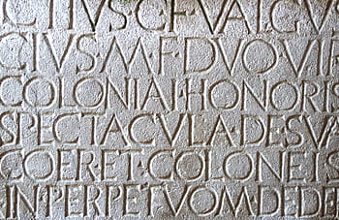
DLT2: Dating Latin Texts with Deep Learning Techniques
~~~~~~~~~~~~
Mitchell Allen and Paul Hoffmann

Slide 2
Many classical texts have been dated with uncertainty, and for some their dates are completely unknown.

Slide 3
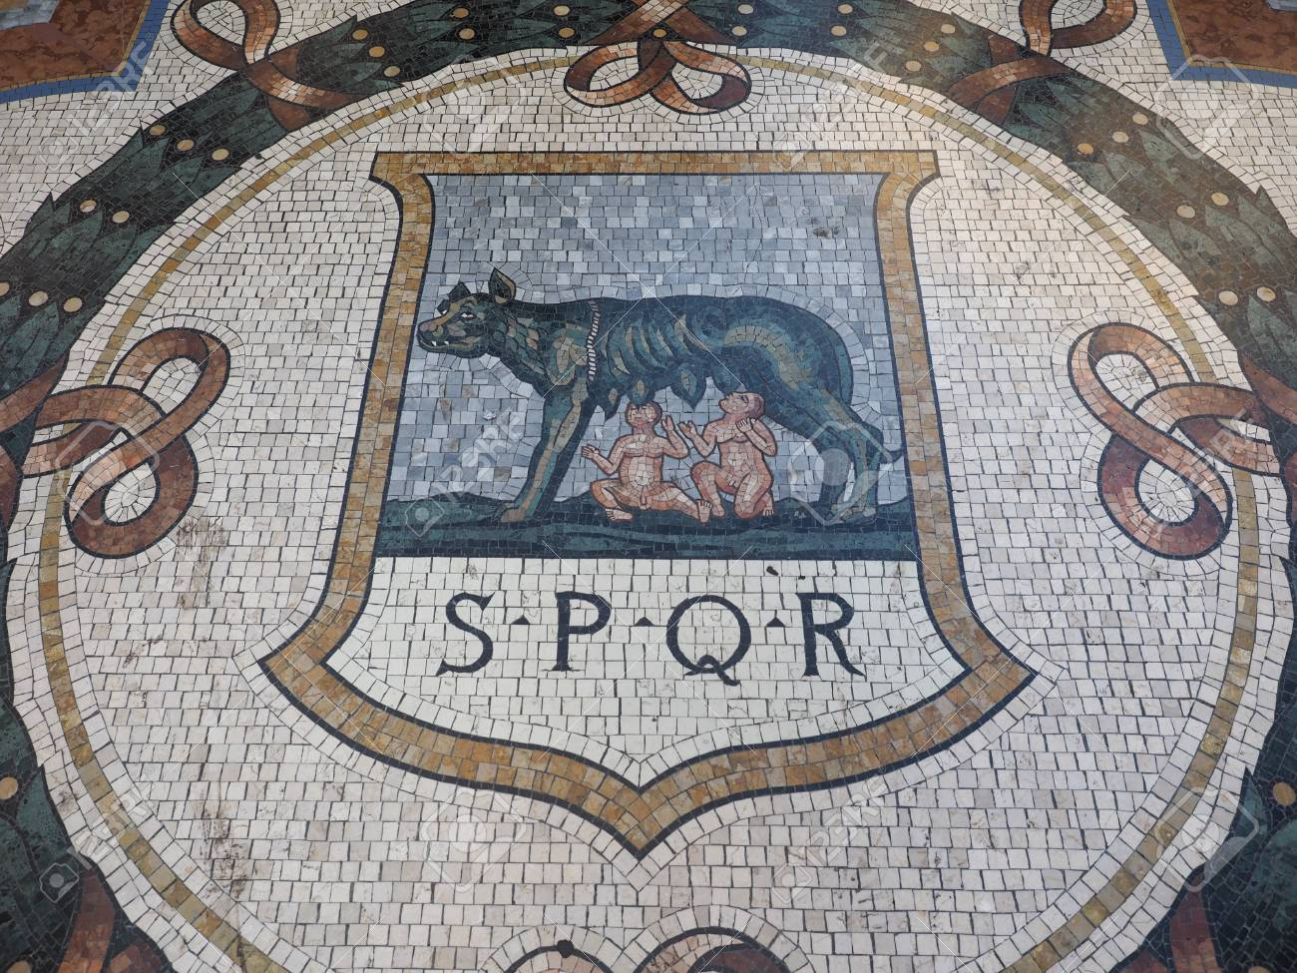
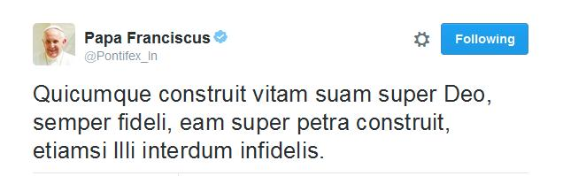
Linguistic Background
Latin is a classical language that was spoken in Rome.
Due to the Roman Empire’s expansion, it spread throughout Europe, as well as parts of Asia and Africa.
Widely employed as the language of international communication until the mid-18th century when it was gradually supplanted by English and French.
Still used today by the Catholic Church.

Slide 4
Automatic Dating - Similar Tasks
Author identification | “Call me Ishmael.” → Melville
Sentiment analysis | “Your product is amazing!” → Positive
Genre classification | “Once upon a time…” → Fiction
Spam filtering | “you’re Account locked!!1!” → Spam
Content moderation | “How I make 9k/mo at home” → Delete
Mood detection | “Welcome to the team!” → Friendly
Private info redaction | “My cc number is *********” → Redacted

Slide 5

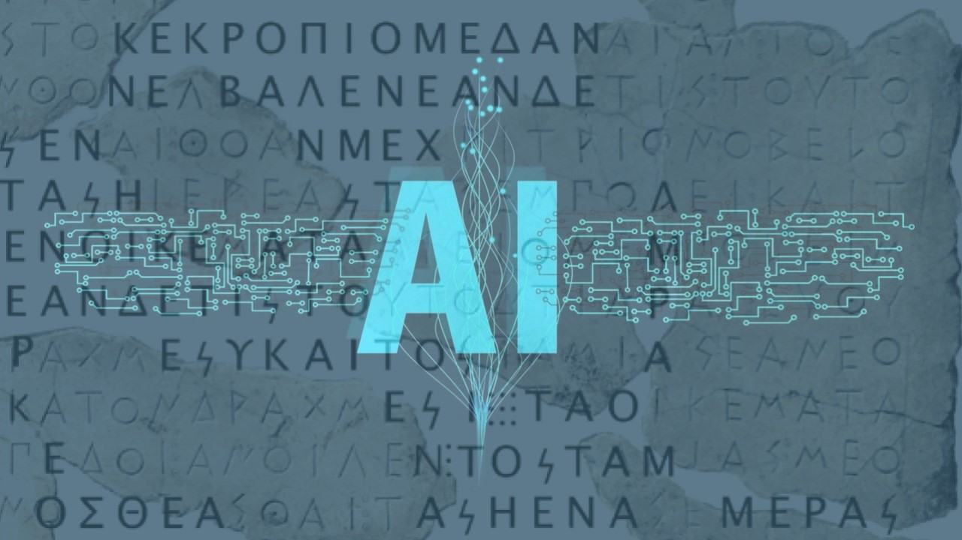
Related Work
As far as we are aware, deep learning has not been used to date Latin texts.
Dating Latin texts usually involves looking for specific words or grammatical features.
There have been several projects using deep learning to date texts in other languages, including Chinese, Irish, Arabic, Sanskrit, and Old English.
Deep Mind’s “Ithaca” for Ancient Greek
Can date texts within 30 years on average
For inscriptions, provides an estimated geolocation
Also restores missing/damaged texts

Slide 6
Model
Embedding
Through experimentation with multiple different styles of models and different parameters, we came to the conclusion that a Bidirectional LSTM model works best for our purposes.
The Embedding layer uses a pretrained Word2Vec of Latin vocabulary from the LiLa knowledge base.
Both Bidirectional LSTM Layers are size 1024.
The Fully Connected Layer is size 8 (aligns with the number of categories).
BI
BI
FC

Slide 7
Python packages
Pandas
Tensorflow 11.0
Cuda–stable version
Numpy
Imblearn

Slide 8
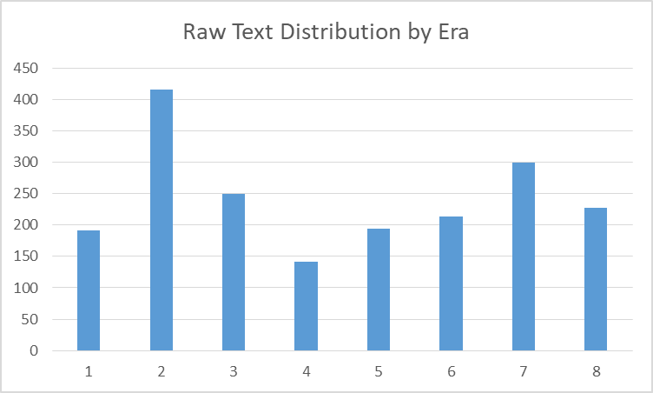
Corpus Information
The Latin Library contains Latin works from various periods
Full corpus is 2,220 texts, but only 1,935 can be dated
Texts are grouped into 8 eras:
Old Latin 700 BC - 75 BC
Caesarean Latin 75 BC - 25 AD
Classical Latin 25 AD - 200 AD
Imperial Latin 200 AD - 400 AD
Late Latin 400 AD - 500 AD
Vulgar Latin 500 AD - 900 AD
Medieval Latin 900 AD - 1300 AD
Modern Latin 1300 AD - Present

Slide 9
Initial Training
Views first 100 words of a text due to GPU limitations
Batch size is 32
Trains for 25 epochs

Slide 10
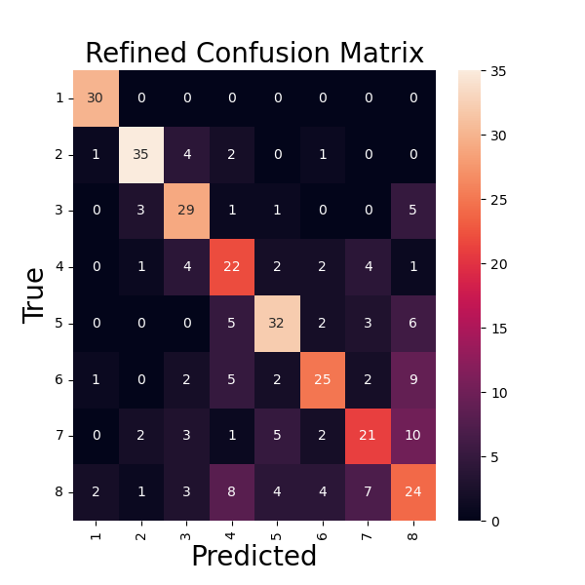
Initial Results
Metrics from our initial
Bidirectional LSTM model
Test Loss | 1.8099
Test Accuracy | 68.44%
Test f1_Score | 69%
Test Precision | 72%
Test Recall | 66%

Slide 11
Data Too Informative
Beginning of most texts contained:
Author’s name
Title
Date written
No standard format made automatic removal difficult
Solution: Skip the first 200 characters of each text, use full texts

Slide 12
Too Computationally Intensive
Unable to run full texts on local machine
Specs: i7, 16GB RAM, 2 GB Nvidia M1000 GPU
Graphics card limitations
Takes a full day to run on Verbnet
Using free credits on Google Cloud Platform
Specs: T4 16 GB GDDR6 GPU
Allowed us to use full text lengths
Runs in ~2 hours

Slide 13
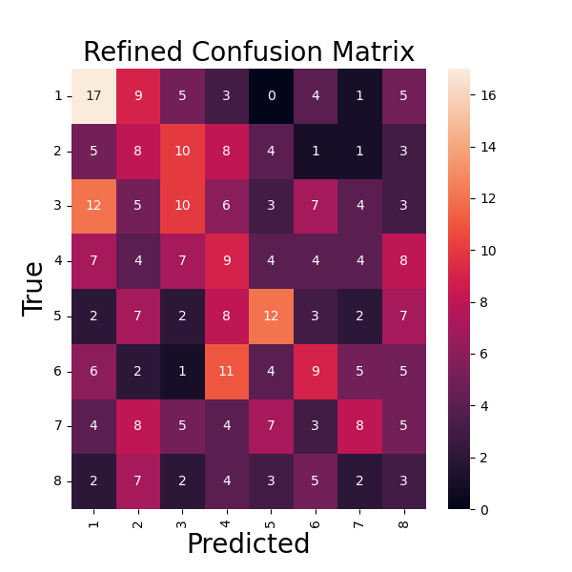
Testing without Authors/Titles/Dates
Batch size = 32
Epochs = 25
Poor results due to lack of data
Solution: split texts into subtexts
Test loss | 4.1472
Test accuracy | 22.42%
Test f1_score | 21%
Test precision | 23%
Test recall | 20%

Slide 14
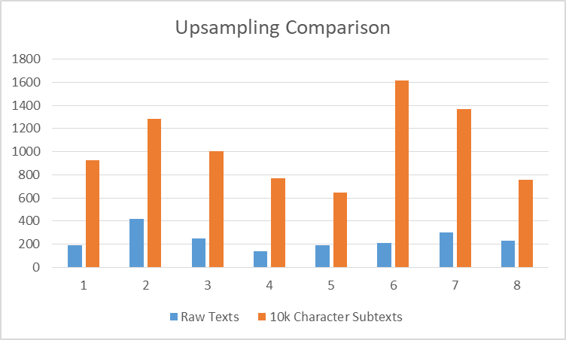
Text Splitting
Already using the largest Latin corpus available
Split each text into 10k character chunks
Each chunk is used as an independent “subtext”
Left punctuation as is, had been removing it originally from full texts
8,366 total subtexts

Slide 15
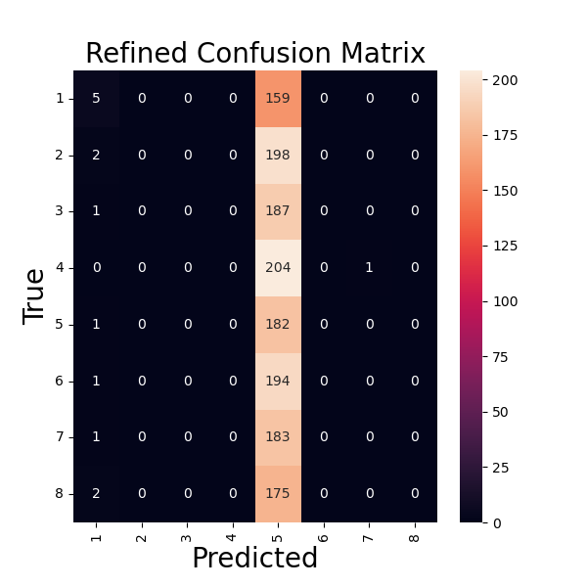
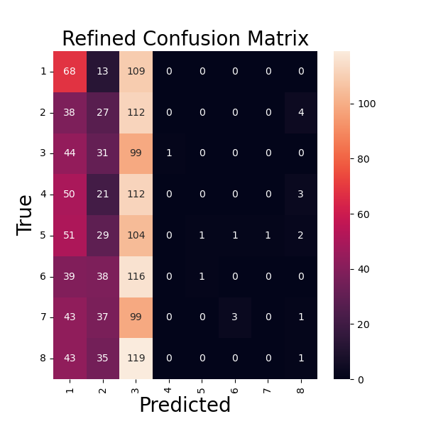
Underfitting
Due to data imbalance,
the model just guessed
the most common era
Solution: Downsampling instead of upsampling
Using the imblearn package for Python

Slide 16
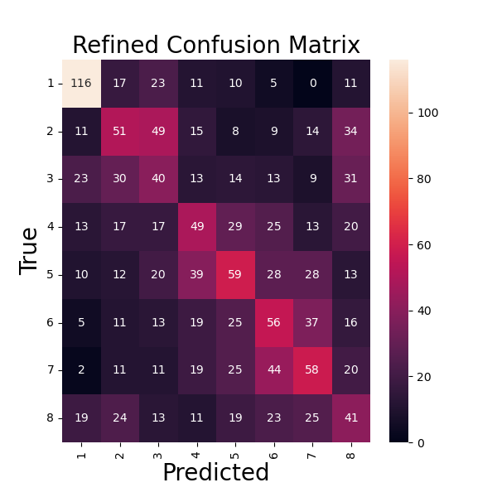
Testing with 10k-Character Subtexts
648 texts per era after downsampling
Batch size = 32
Epochs = 50
Test Loss | 4.8734
Test Accuracy | 31.42%
Test f1_Score | 31%
Test Precision | 32%
Test Recall | 30%

Slide 17
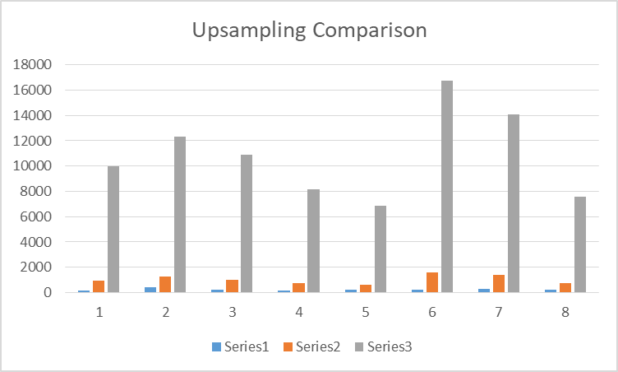
Even Shorter Subtexts
1000-character windows
86,577 total subtexts
Punctuation still left in

Slide 18
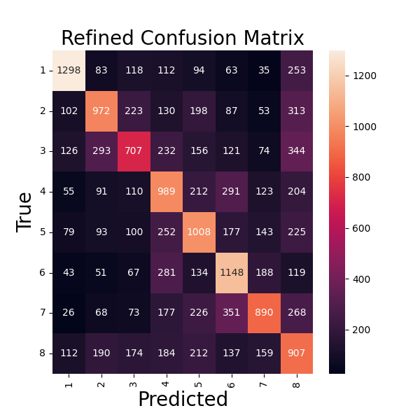
Testing with 1k-Character Subtexts
6,885 texts per era after downsampling
Batch size = 32
Epochs = 20
Test Loss | 3.3389
Test Accuracy | 47.92%
Test f1_Score | 48%
Test Precision | 49%
Test Recall | 47%

Slide 19
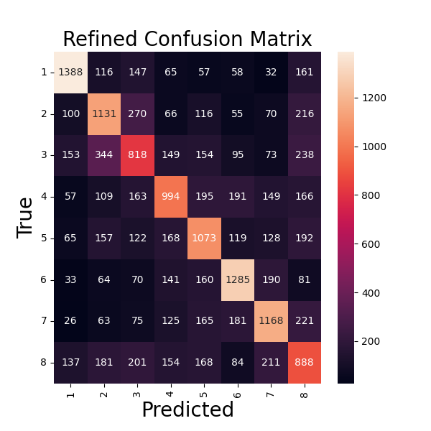
Effects of Removing Punctuation
Still 1k-character subtexts
Batch size = 32
Epochs = 20
Test Loss | 2.9808
Test Accuracy | 54.01%
Test f1_Score | 54%
Test Precision | 55%
Test Recall | 53%

Slide 20
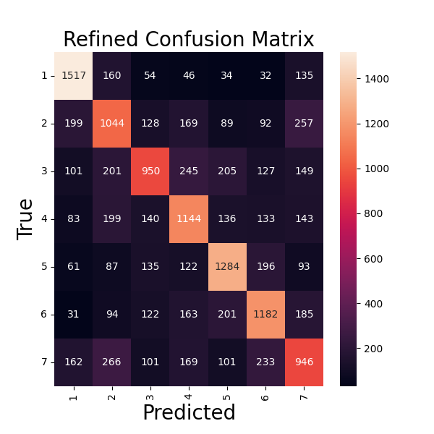
Merging Eras 2 and 3
⅔ and 4 become more easily confused
Some improvement for other eras
Batch size = 32
Epochs = 15
Test Loss | 2.3443
Test Accuracy | 58.26%
Test f1_Score | 58%
Test Precision | 59%
Test Recall | 57%

Slide 21
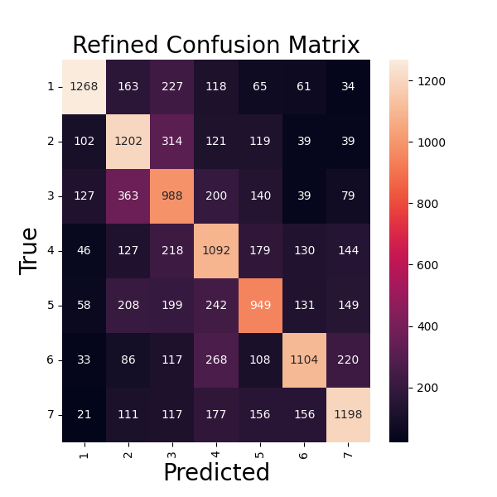
Removing Modern Latin
Similar level of improvement
Era 7 gets slightly more confused
Batch size = 32
Epochs = 10
Test Loss | 2.0736
Test Accuracy | 57.56%
Test f1_Score | 58%
Test Precision | 59%
Test Recall | 56%

Slide 22
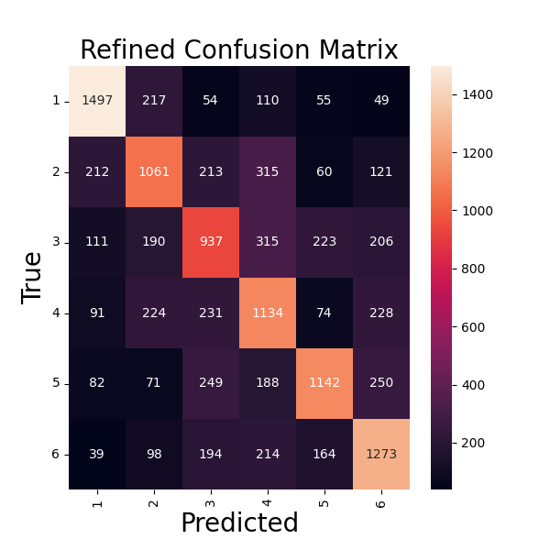
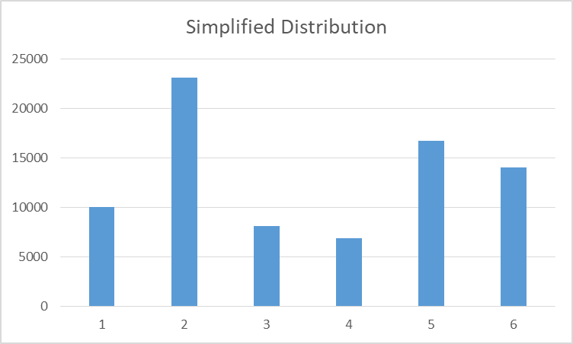
Top Model - Combine ⅔ and Remove Modern
Batch size = 32
Epochs = 10
Test Loss | 1.8284
Test Accuracy | 60.98%
Test f1_Score | 61%
Test Precision | 63%
Test Recall | 60%

Slide 23
Future Work
Shrink subtext length further.
See if 500-character windows would lead to further improvement.
Use narrower time ranges for texts.
100-year windows could replace the current 6-8 era divisions. DeepMind’s Ithaca uses 10-year windows.
Changing model structure.
Now that data handling has improved, can the original model structure be improved?
Extend this approach to other less-studied classical languages.
Syriac, Ge’ez, Armenian, Assyrian, etc.

Slide 24
Thank you!

Slide 25
Feedback
Add timeline with historical events and era spans
Try fewer eras to see if it detects larger trends
Try more eras to see if that forces finer distinctions
Parse out features
Explain major differences between Latin eras
Reframe motivations for shifting eras (modern Latin already dated correctly)

